Slide 1
MUTHURANGAM GOVT ARTS AND SCIENCE COLLEGE
VELLORE
RETAIL MANAGEMENT APPLICATION USING SALESFORCE
PROJECT SUBMITTED BY
TEAM LEADER : ANUPRIYA.S
TEAM MEM : AARTHI .A
TEAM MEM : GOPIKA.S
TEAM MEM : KEERTHIGA.M

Slide 2
CONTENT Milestone-1: Creating Developer Account Account Activation Milestone-2: OBJECT Creation of object Dispatch/Tracking Fields available on Dispatch / tracking Milestone-3: RELATIONSHIP B/W OBJECTs Creation of relationships between objects Milestone-4: APPLICATION Creation of application Milestone-5 LAYOUTS Creation of custom tabs

Slide 3
Milestone-6 USER: Creaation of user Milestone-7 VALIDATION RULES: Creation of validation rule Milestone-8:REPORT Creation of report Milestone-9:DASHBOARDS Creation of dashboard

Slide 4
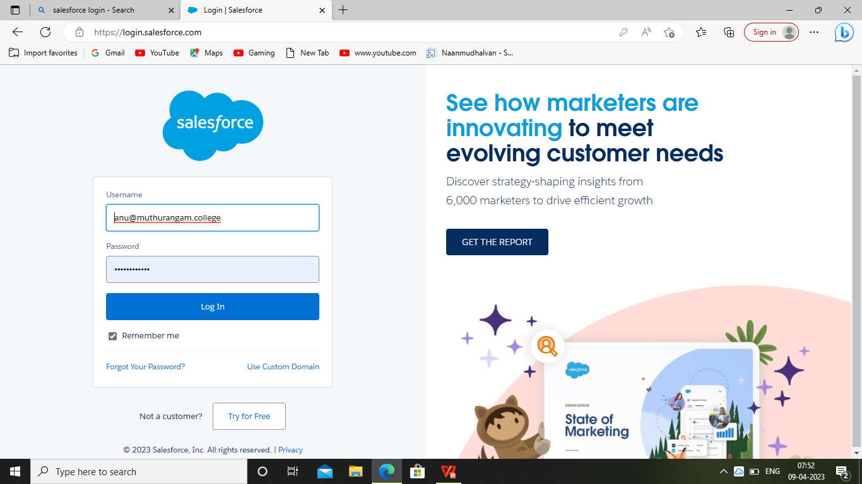
MILESTONE 1 creations of developer account 1. Go to developers.salesforce.com 2. Click on sign up 3. Enter the newly created user name and password
Fig 1

Slide 5
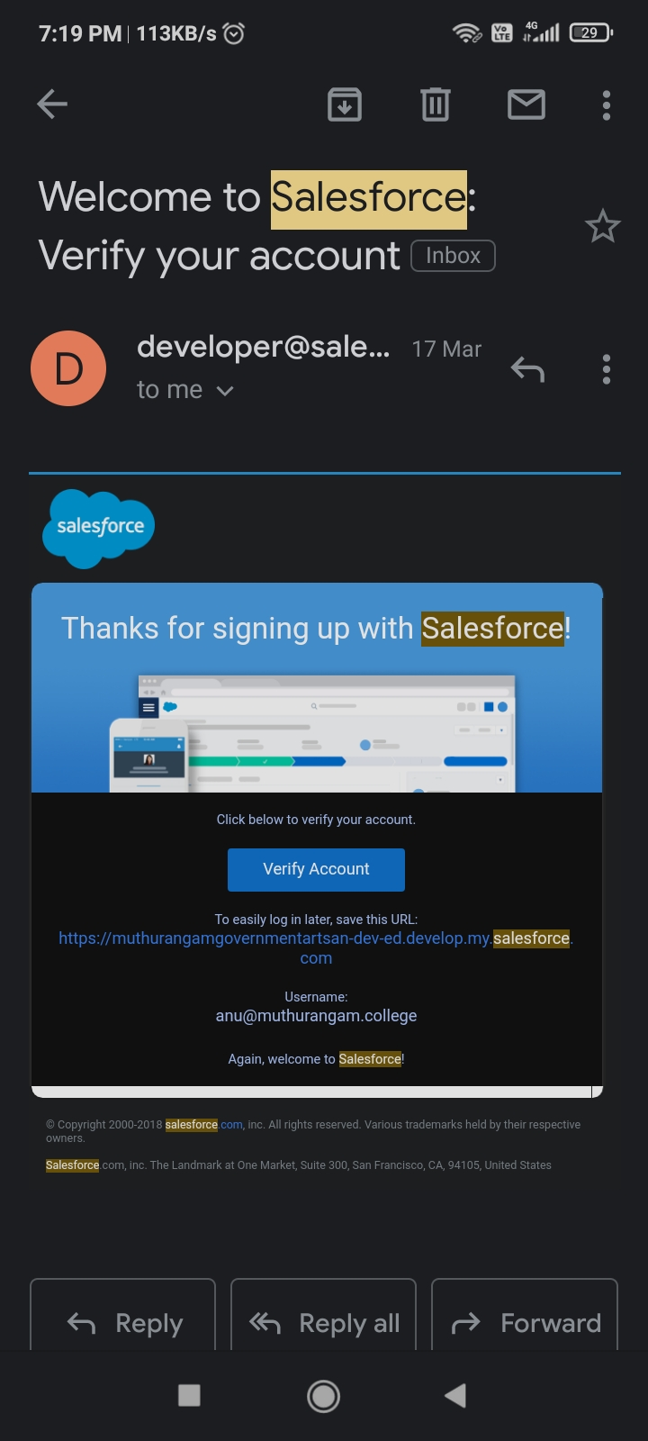
ACCOUNT ACTIVATION Go to the inbox of the email that you used while signing up.click on the verify account to activate your account,the email may take 5 to 10 min .Fig 2

Slide 6
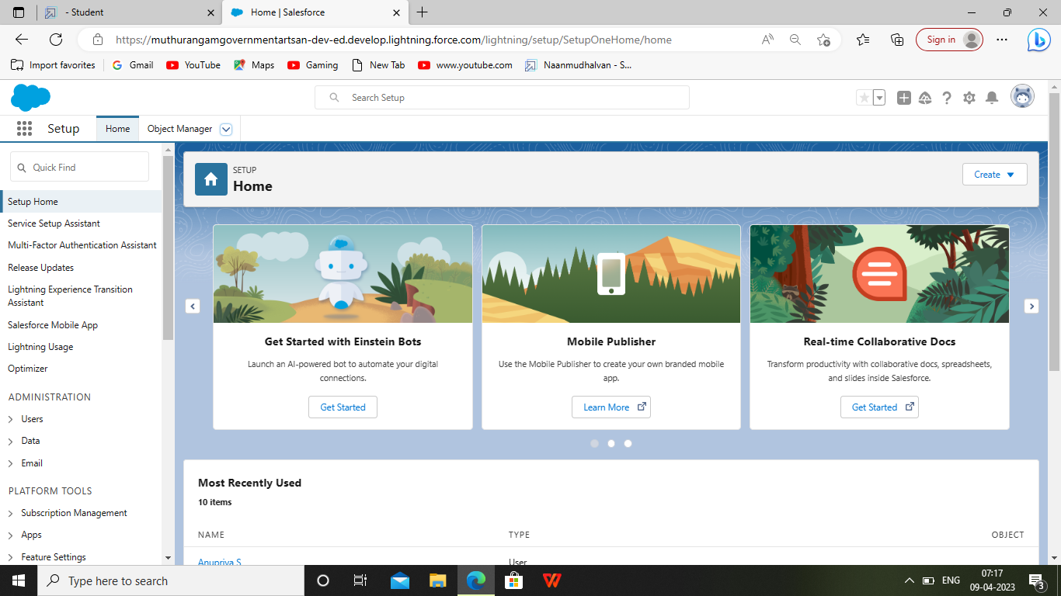
ACCOUNT ACTIVATION After activating account , the home page of the salesforce is in fig 3
Fig 3

Slide 7
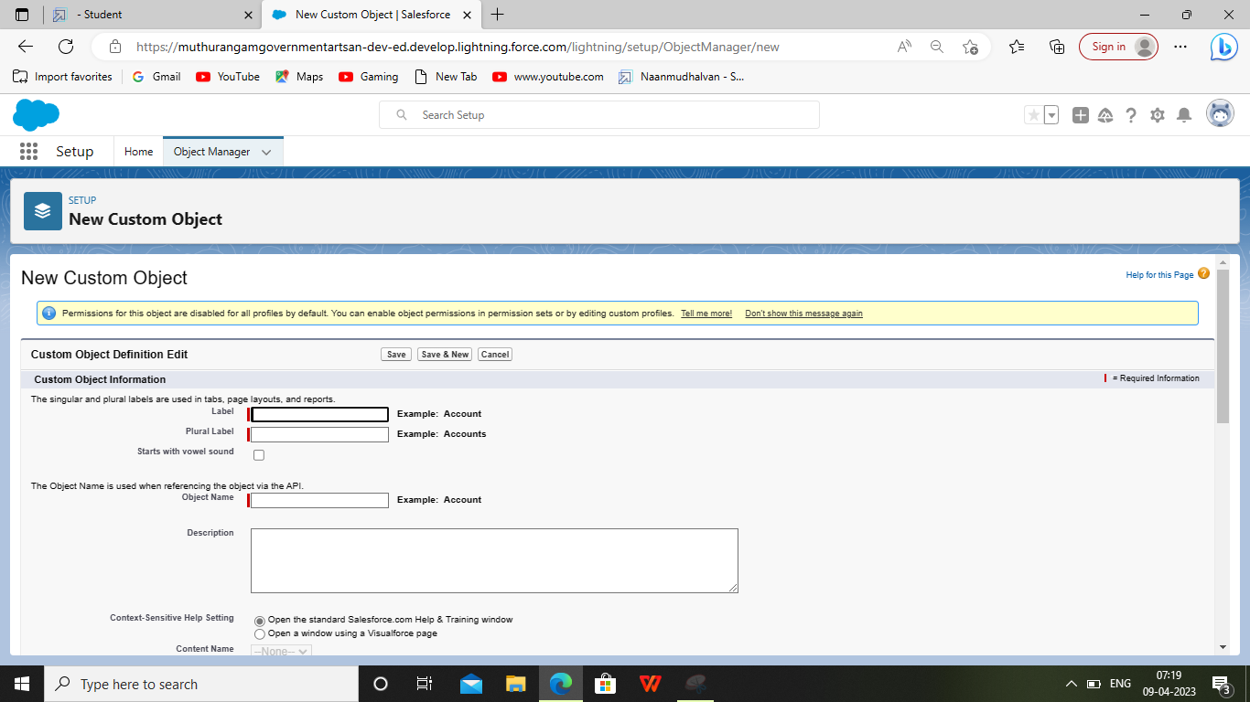
Milestone-2 OBJECT Creation of object dispatch/tracking
Navigate custome object and edit the object name

Slide 8
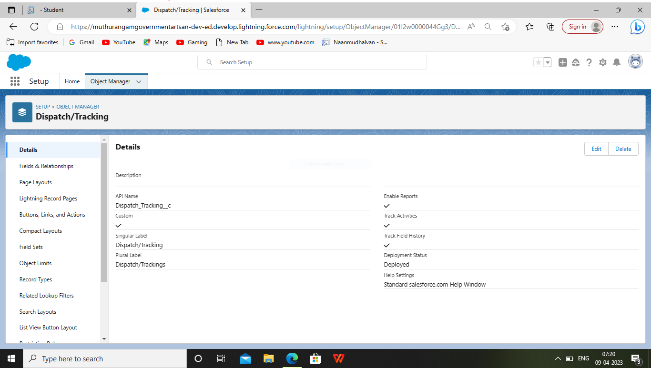
Creation of field of dispatch and tracking

Slide 9
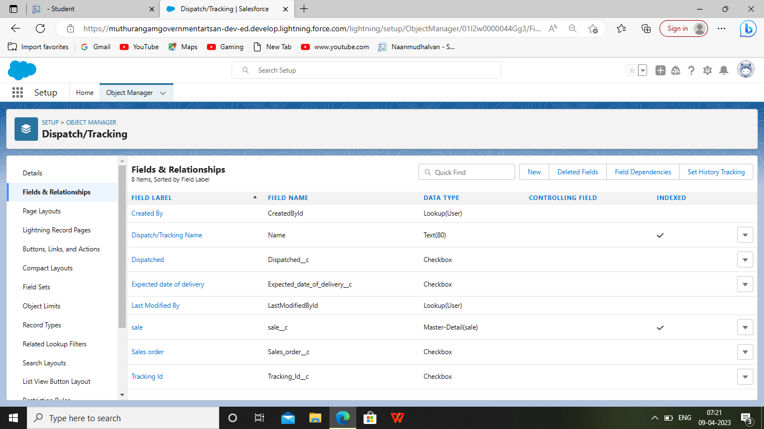
1. Select your object from object selection has dispatch/tracking 2. And select the obtion fields and relationship. 3. At the top right side you can find a new select that option 4. Now you have to select data type, checkbox has datatype 5.It give the lable name as dispatched

Slide 10
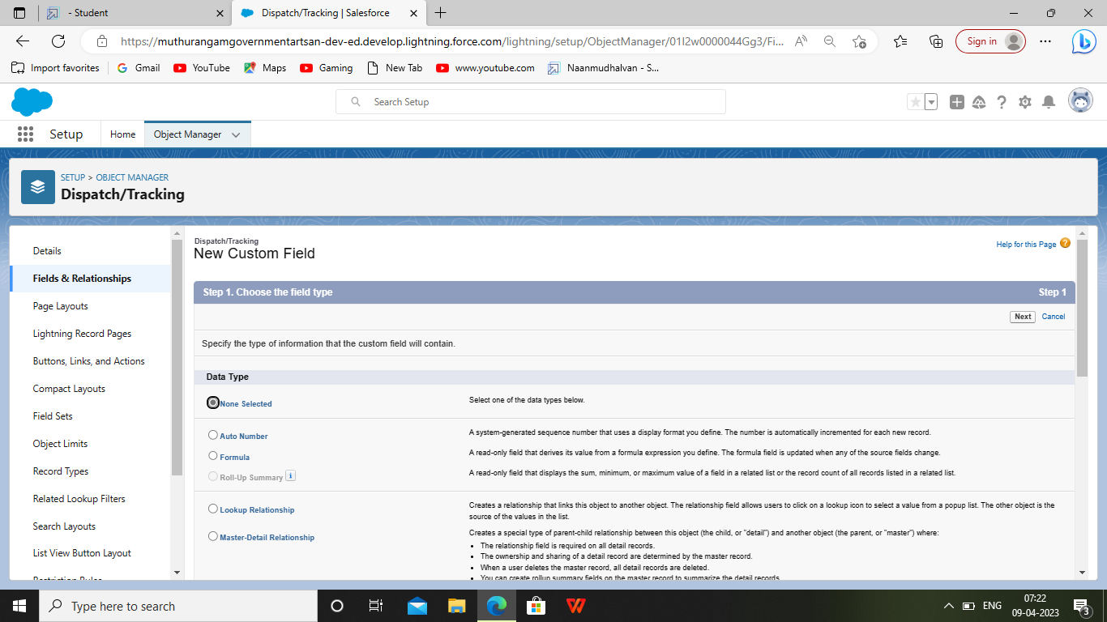
Milesone 3: Relationship between objects 1. Go to the setup option from the home page and click on it 2. Go to the object manager and select dispatch/tracking object from the list 3. And select fields and relationships and click on new

Slide 11
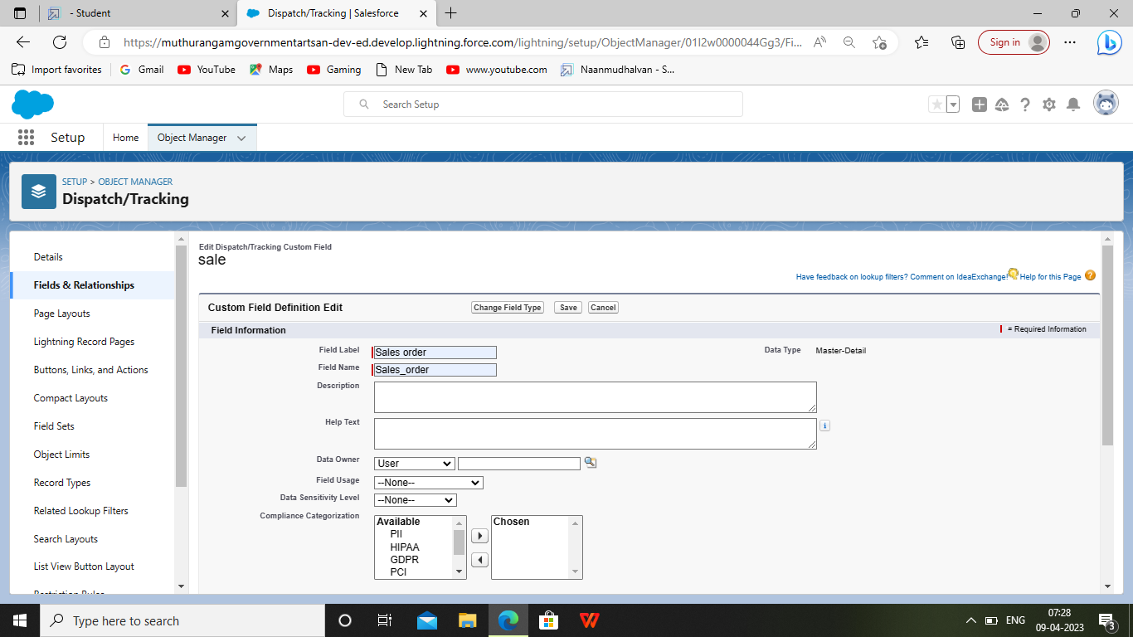
4. Select the data type as master detail relationshp 5. And select related to the oject as sales order, and click on next 6. You will navigate to the lable name page where you give the label name for the field , give it has sales order and click next

Slide 12
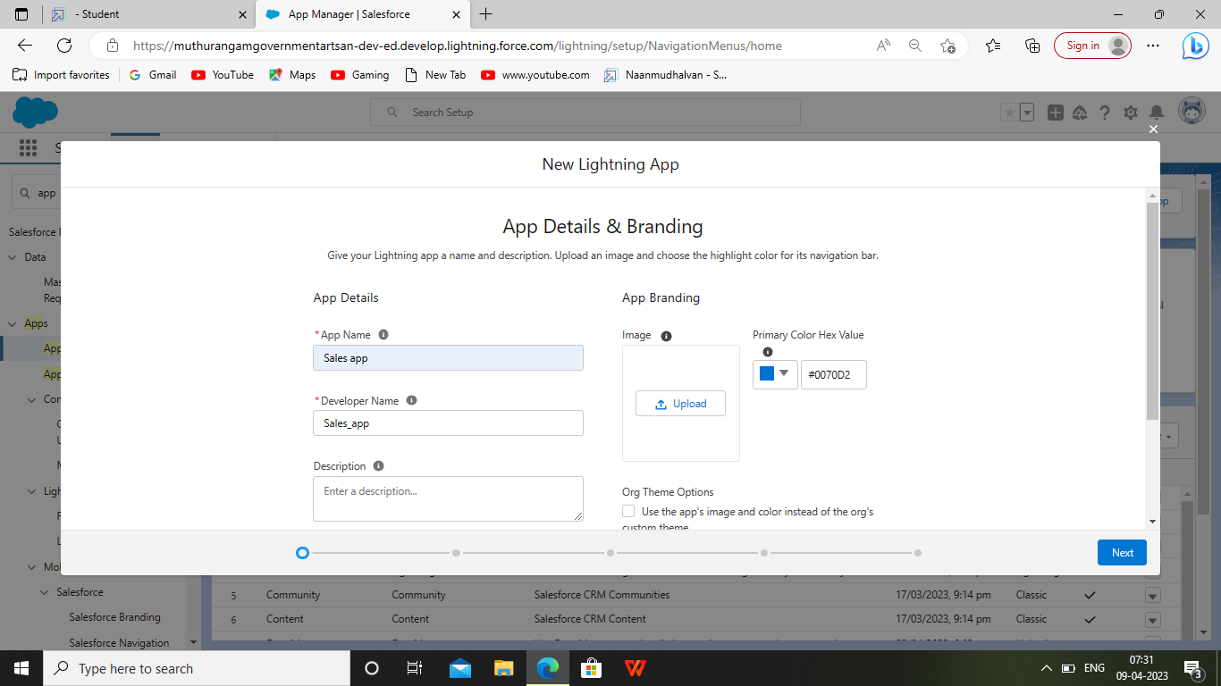
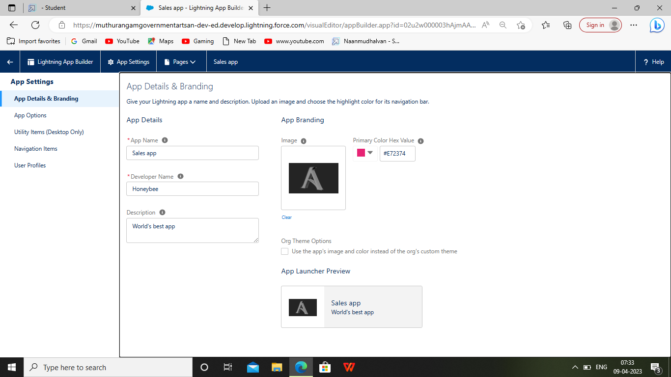
Milestone-4 APPLICATION 1. Creation of application by selecting an option for new lightning app 2. Upload the picture and choose the navigation style

Slide 13
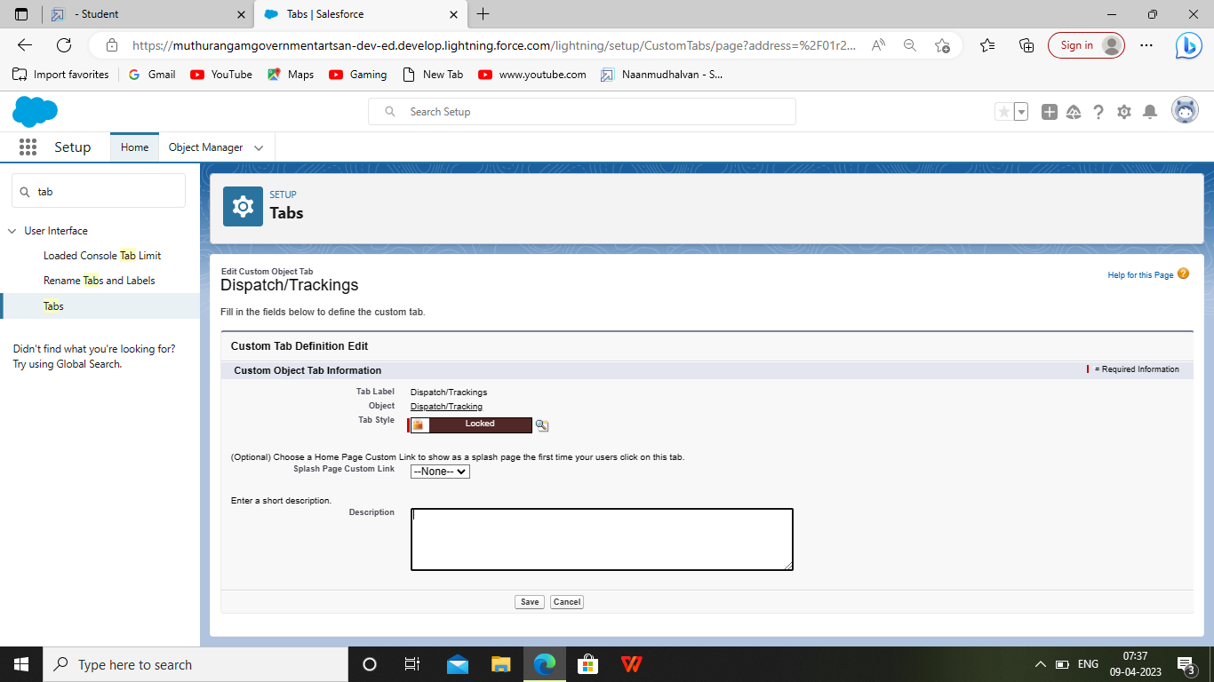
Milestone-5:Layout Creation of custom tabs 1 .Click the Home tab, Enter tabs in quick find and select tabs 2 ,Under custom object tabs click new 3. For object select warehouset 4 .For tab style select any icon .

Slide 14
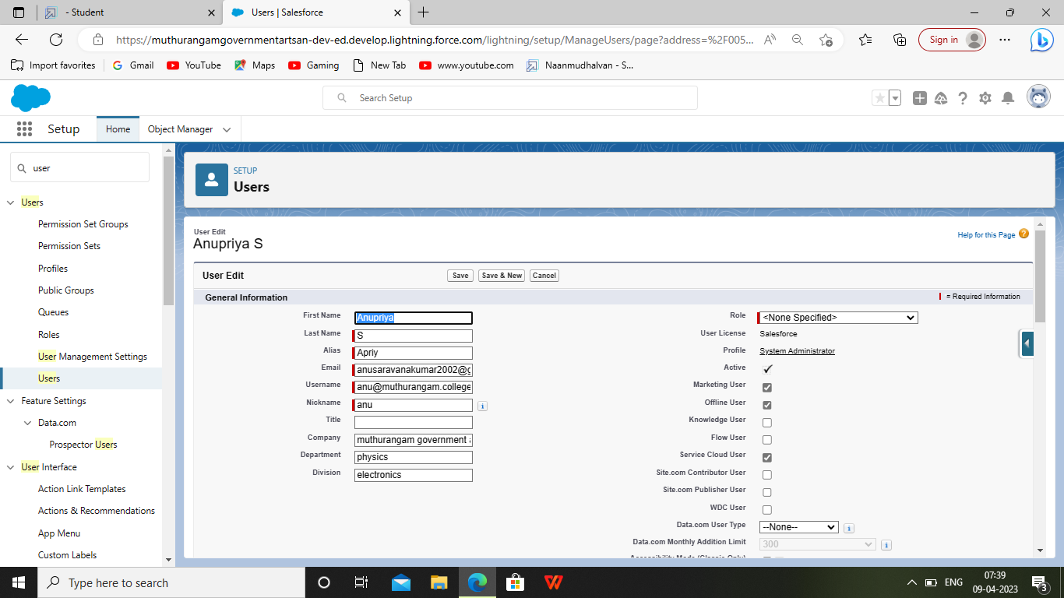
Milestone-6: Users Creations of users

Slide 15
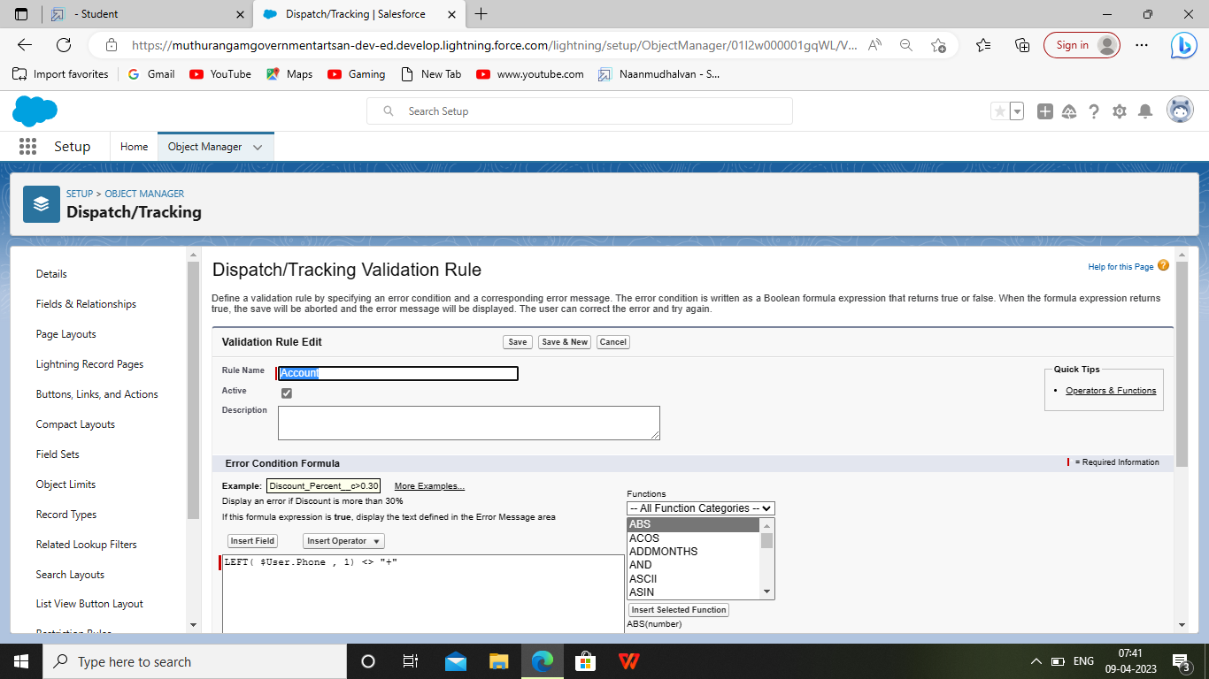
Milestone-7: validation rules creation of validation rule and cross object formula

Slide 16
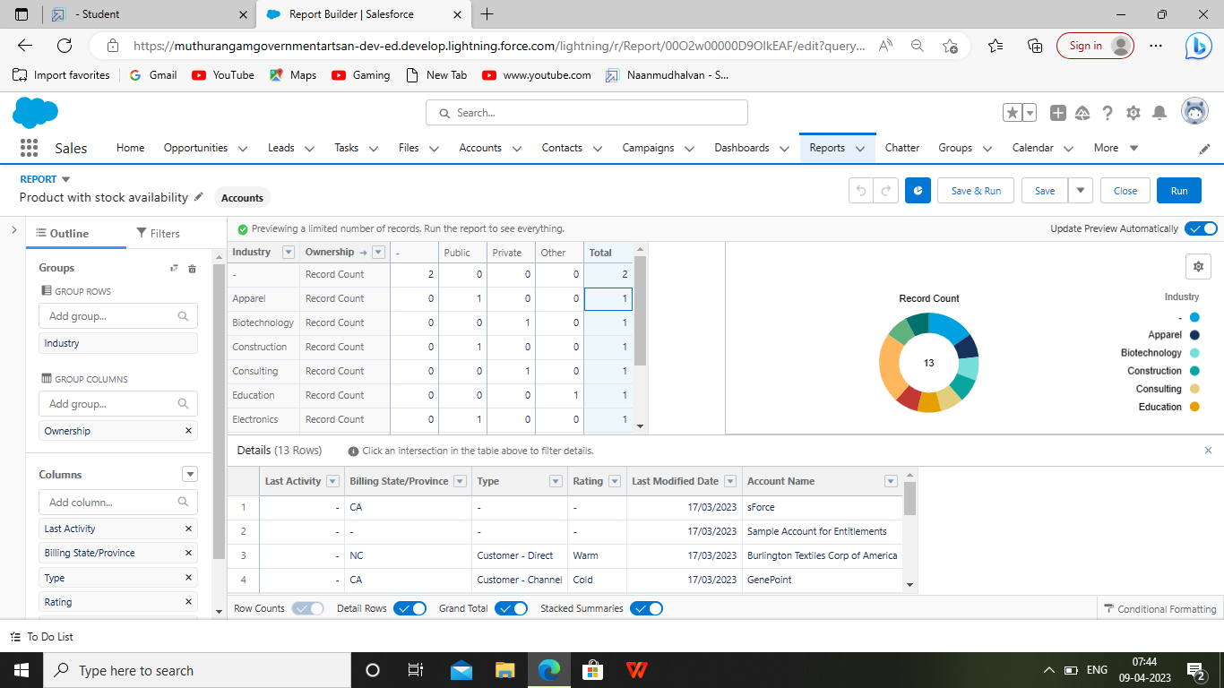
Milestone -8: Reports Creation of report 1. Click on the app launcher and search for reports 2. select new report for the record type category select other reports 3. Give the label name products with stock availability 4. Click on save and run for saving the report

Slide 17
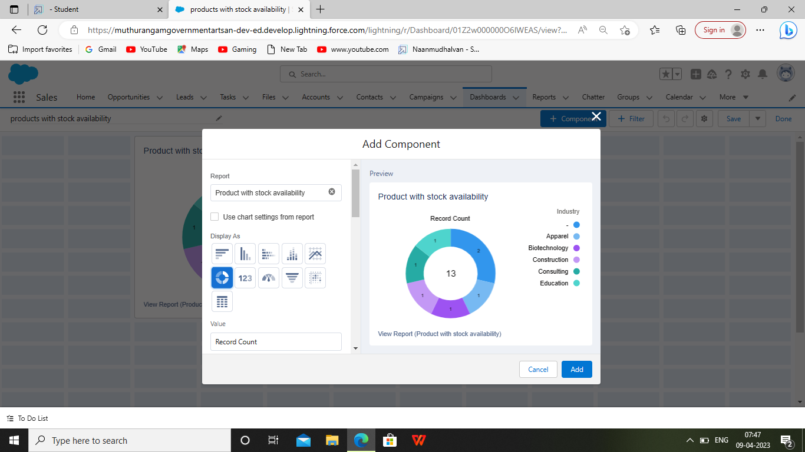
Milestone-9: Dashboard Creation of dashboard 1. Ensure that value is record count and sliccds by product name 2. Leave the default value 3. Click on add 4. And save the dashboard

Slide 18
END
OUR SINCERE GRATITUDE TO
SALESFORCE
SMARTBRIDGE(SMART INTERNZ)

